Slide 1



Data-driven prognostic model for temperature field in additive manufacturing based on the high-fidelity thermal-fluid flow simulation
Fan CHEN
(4th year PHD student)
Email: e0348805@u.nus.edu
Supervisor: Prof. Wentao YAN
Email: mpeyanw@nus.edu.sg

Slide 2
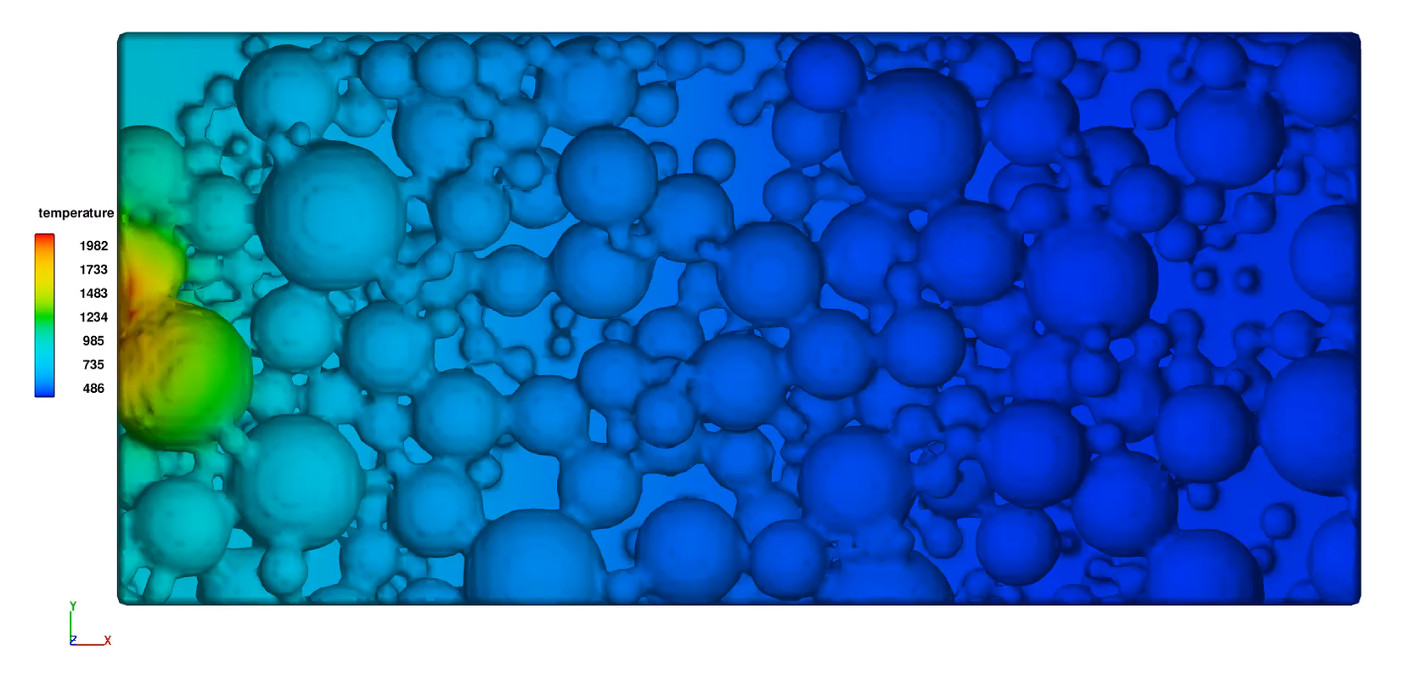
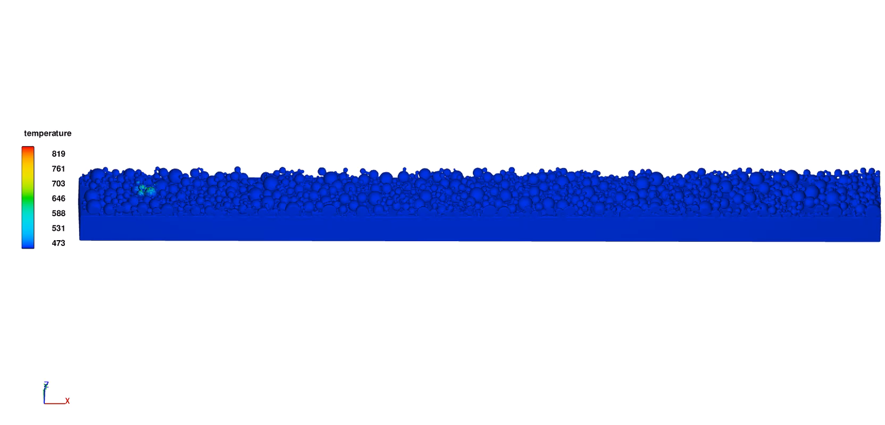
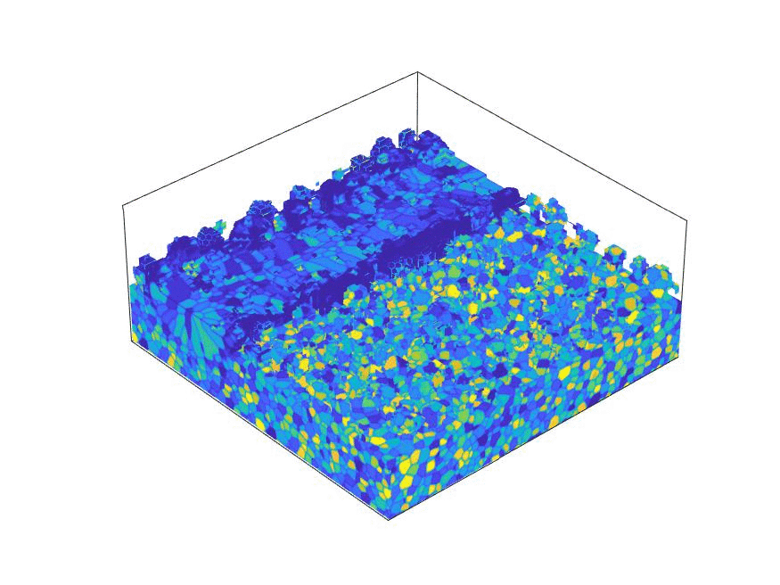

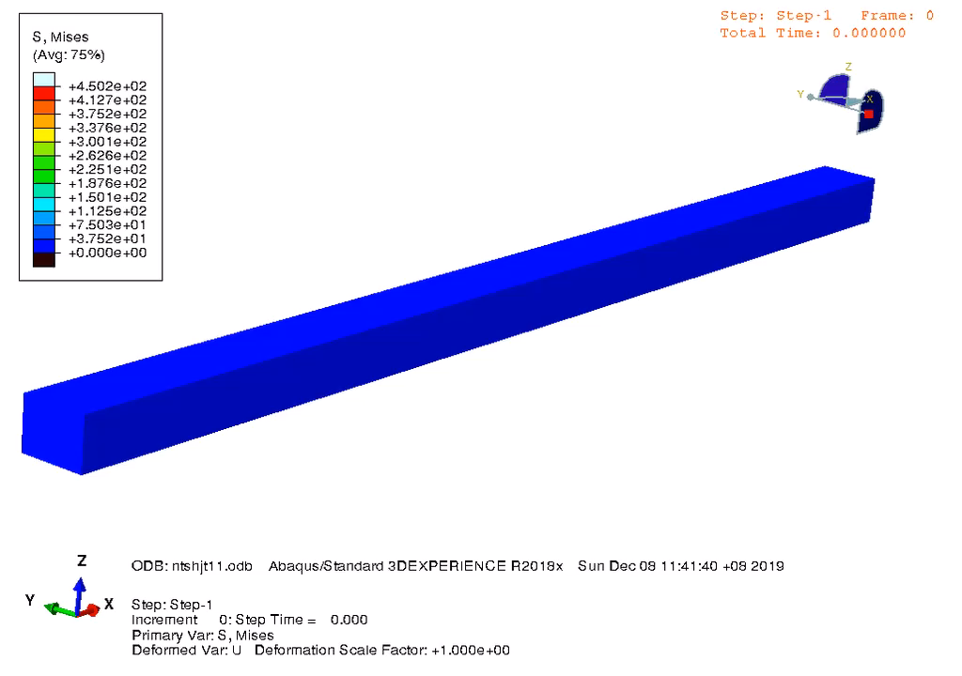
Problem
Powder bed fusion (PBF)
Phase transfer:
Melting and solidification
Evaporation, etc.
Thermal-fluid flow simulation
Heat transfer:
Heat absorption
Heat conduction, radiation, etc.
Fluid dynamics:
Marangoni convection
Capillarity, etc.
Grain growth
Thermal stress
Heat transfer
High computational cost of the thermal-fluid flow simulation;
Complex pre-processing of the temperature profiles;
High computational cost of the temperature loading.
Fluid dynamics
P, v
Data-driven model
T

Slide 3
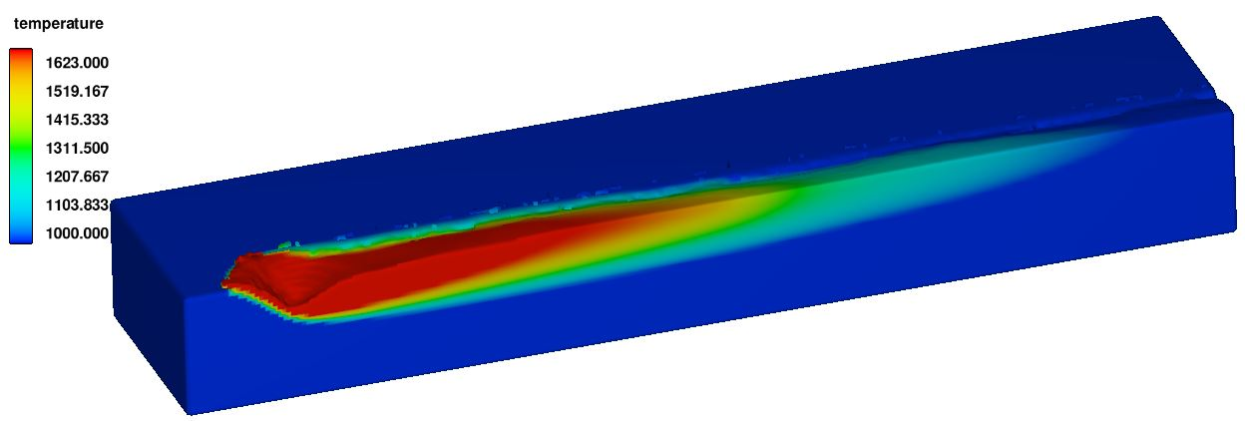
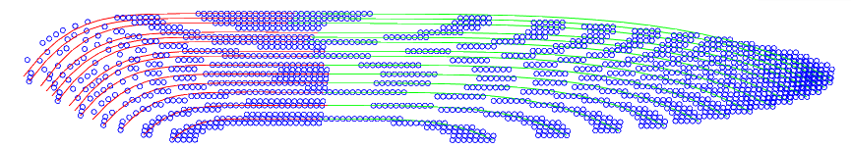
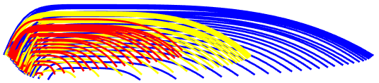
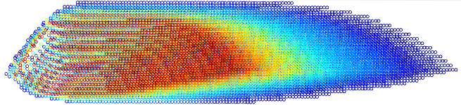
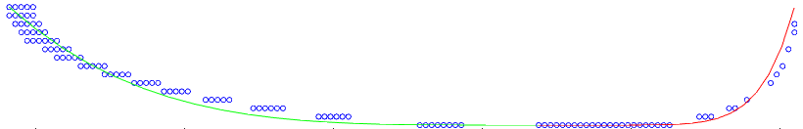
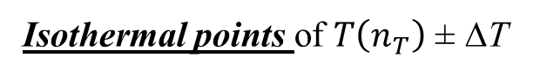
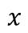
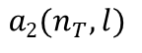
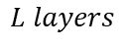
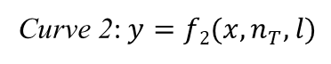
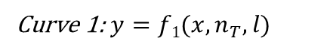
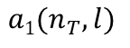
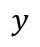
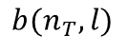
Overall framework
Training data: thermal-fluid flow simulation
Isothermal points of $T\left(n_{T}\right)$ ± ∆T
z
x
Discretize & extract
Data preparation
$$L layers$$
y
Curve fitting &
parameterization
Isotherms
Regression/machine learning algorithms
INPUT:
manufacturing parameters
z
x
y
$$y$$
Curve 1: $y=f1(x,n_{T},l)$
Curve 2: $y=f2(x,n_{T},l)$
EVALUATION:
Thermal stress model/
Grain growth model
$$b(n_{T},l)$$
Region 1
Region 2
O
$$x$$
OUTPUT: isotherm dimensions to reconstruct temperature field
$$a1(n_{T},l)$$
$$a2(n_{T},l)$$
Curve-fitting of the $T\left(n_{T}\right)$ isothermal points at the $l^{th}$ layer

Slide 4
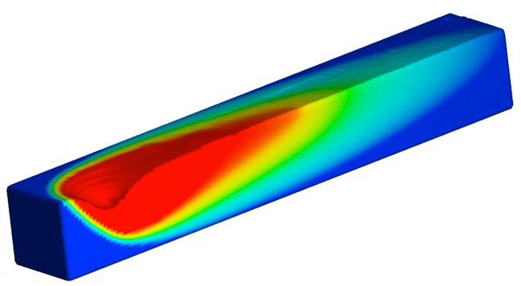
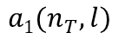
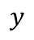

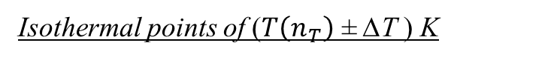
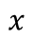
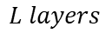
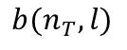
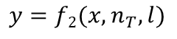
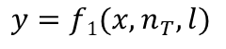
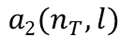
Model construction
Temperature field parameterization
z
Training data: thermal-fluid flow simulation
Isothermal points of ($T\left(n_{T}\right)$ ± ∆T ) K
x
y
z
Discretize & extract
$$L layers$$
x
y
Curve fitting & parameterization
Isotherms
z
x
$$y=f1(x,n_{T},l)$$
$$y=f2(x,n_{T},l)$$
y
$$b(n_{T},l)$$
$$x$$
O
$$a1(n_{T},l)$$
$$y$$
$$a2(n_{T},l)$$
Curve-fitting of the $T\left(n_{T}\right)$ isothermal points at the $l^{th}$ layer
Output variables: $a_{1}, a_{2}, b$

Slide 5
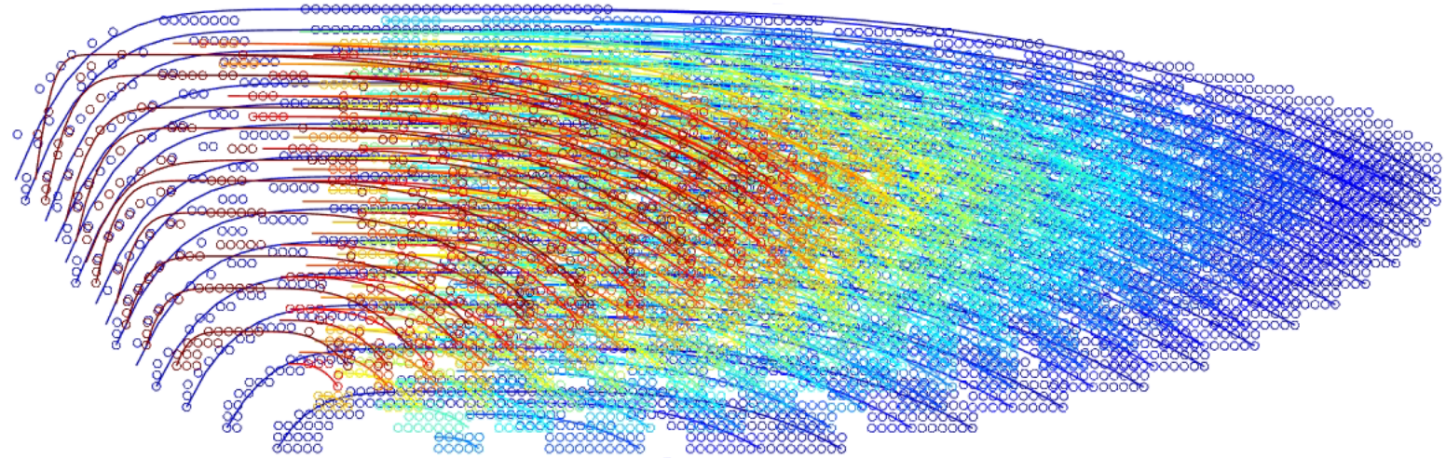
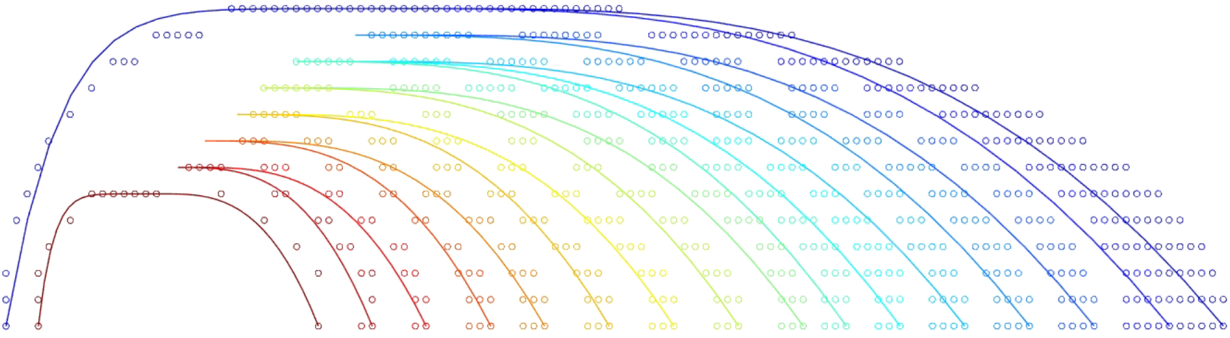
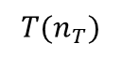
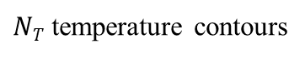
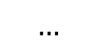
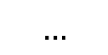
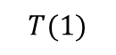
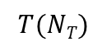
Model construction
Accuracy of the isotherms extraction
(Inconel 625)
The grain evolution and thermal stress are essentially determined by the temperature field at and around the molten pool boundary (1000~1560 K).
z
x
y
One of the layers
x
y
b
$$T(NT)$$
$$…$$
$$T(n_{T})$$
$$…$$
$$T(1)$$
=
=
Half-width b captured inaccurately: Different contours share the same half-width b due to the limited mesh size.
1560 K
1000 K
Two main factors:
Contour numbers
Mesh size of the simulation
$NT$ temperature contours
Below 1000 K, the solid-state phase transformations barely occur and the residual stresses do not change much.

Slide 6
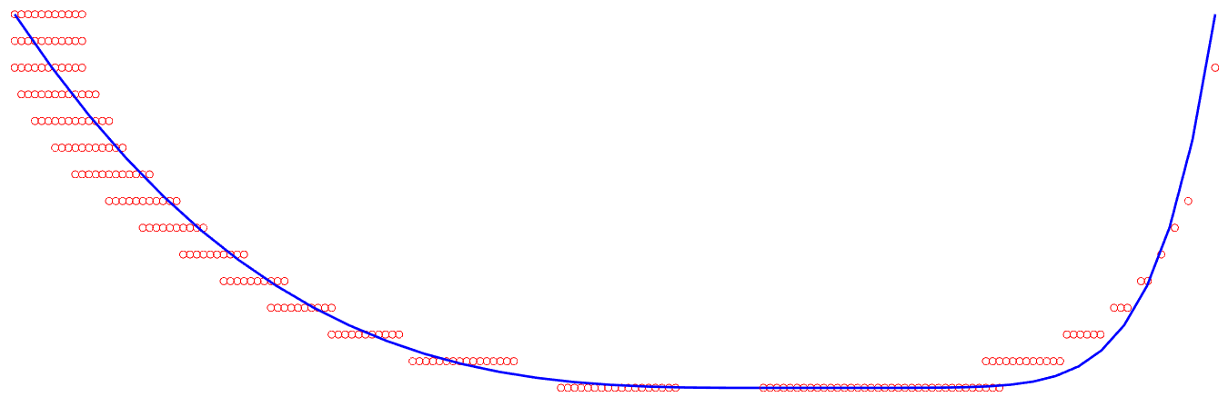
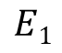
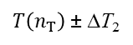
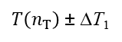
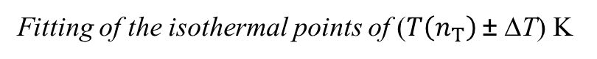


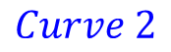
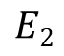
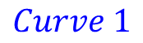
Model construction
Temperature field parameterization
Output variable: $L$
Curve shape and temperature gradient in two regions are quite different.
Region 1
Split line
x
Region 2
Maximum-width position
y
$$E1$$
$$E2$$
$$Isothermal points$$
$T\left(n_{T}\right)$ ± ∆T₁
Maximum-width segment
$$Curve 1$$
$$Curve 2$$
$T\left(n_{T}\right)$ ± ∆T₂
Symmetric central line
Reference point
Fitting of the isothermal points of ($T\left(n_{T}\right)$ ± ∆T) K

Slide 7


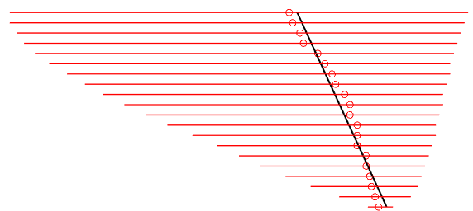
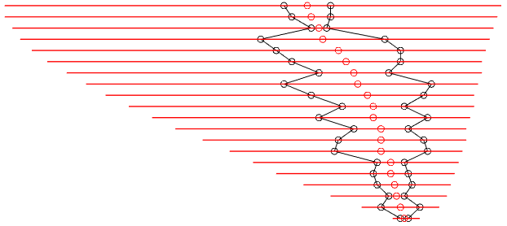


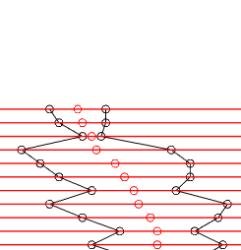
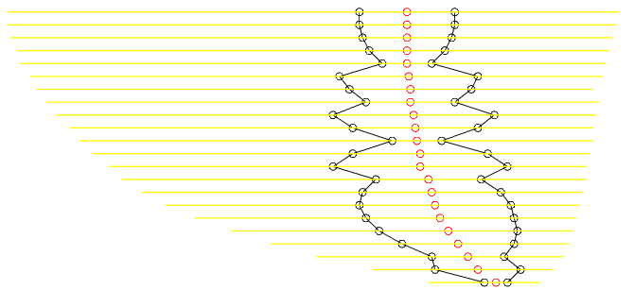
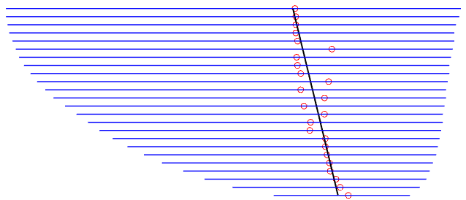
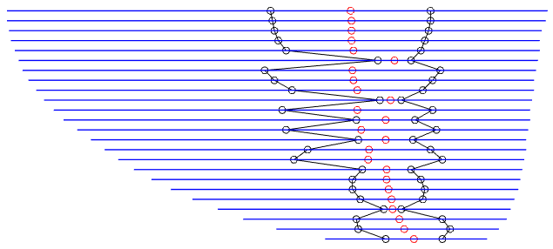






















Model construction
Fitting of the reference lines
Longitudinal symmetric plane
Base point
$$∆x_{i}$$
$$…$$
$$…$$
$$∆x_{1}$$
$$T(NT)$$
$$T(i)$$
$$T(1)$$
z
The two endpoints E₁, E₂ are highly irregular;
The center points (E₁+E₂)/2 are well aligned.
Free surface
$$T(NT)$$
$$θ_{N_{T} }$$
x
$$…$$
$$∆x_{i}$$
$$T(i)$$
z
$$\frac{\left(E_{1}+E_{2}\right)}{2}$$
Reference lines
x
$$E_{1}$$
$$E_{2}$$
$$θ_{i}$$
$$…$$
$$∆x_{1}$$
z
$$T(1)$$
3D view
Combination of the isotherms
x
y
$$θ_{1}$$
L layers
Well aligned
Irregular
Output variables: $∆x, θ, L$
Fitting reference line
Fixed layer distance

Slide 8


Model construction
(Inconel 625)
Input: manufacturing parameters for the thermal-fluid flow simulation samples
$$\left[V,P\right]$$
(Samples. No.1 ~42, Each case costs about 100 CPU hours)
Power (W)
Data-driven algorithms
Velocity (m/s)
Output: the geometry features of the isotherms
$$[a_{1},a_{2},b,L,θ,∆x,T_{peak}]$$

Slide 9






Model construction
Data-driven algorithms
Two main factors:
High accuracy
Fast predicting speed
Gaussian process regression (GPR)
Feedforward neuronal network
Quadratic regression (QR)
Support vector regression (SVR), Linear regression (LR)

Slide 10










Model setting
Fitting function for isotherms
(Tested on No. 1~ No. 26)
Fitting performance
$$y=f2$$
$$y=f1$$
Curve 2
Ellipse function
$$b(n_{T},l)$$
Region 1
Region 2
$$x$$
O
$$a1$$
$$a2$$
$$y$$
Ellipse function:
Curve 1
Polynomial function:
Ellipse function
Mean square errors:

Slide 11















Model setting
Fitting performance of different functions
10th layer of sample no. 26
Region 1:
1000 K
1050 K
1110 K
1270 K
1340 K
1560 K
Ellipse fitting
Polynomial fitting
Isothermal points in thermal-fluid flow simulation
$${Index}_{1}=4$$
$${Index}_{1}=6$$
$${Index}_{1}=8$$
Region 2:
Ellipse fitting
Polynomial fitting
$${Index}_{2}=2$$
$${Index}_{2}=3$$
$${Index}_{2}=4$$

Slide 12




Model setting
Performance (MSE) of different algorithms on different output variables
Training data sets: no.1~ no.26
Layer numbers L
Slope angle θ
L layers
$$θ$$
$$O$$

Slide 13









Model setting
Performance (MSE) of different algorithms on different output variables
Training data sets: no.1~ no.26
Relative distance ∆x
Range (10⁻⁹ m²)
Range (10⁻⁹ m²)
$$a1$$
$$a2$$
$$∆x_{i}$$
Relative distance
$$∆x_{i+1}$$
Range (10⁻⁹ m²)
$$b$$
O
$$a1$$
$$a2$$
$$b$$

Slide 14

Model setting
Different training datasets
Predicted isotherms of Region 2
Testing Sample no. 41
V =1 m/s
P =40 W

Slide 15
























Model evaluation
Temperature field reconstruction
Predicted isotherms
z
Temperature calculation by the interpolation
$$Plane γ_{G}$$
Global base line l_{b}
z
$$y′$$
x
y
$$A({x′}_{A},{y′}_{A})$$
$$B({x′}_{B},{y′}_{B})$$
j ^{th} layer
x
$$x′$$
Temperature field reconstruction
y
Local coordinate system in plane $γ_{G}$
G
( j+1)^{th} layer
$$D({x′}_{D},{y′}_{D})$$
$$C({x′}_{C},{y′}_{C})$$
$$Plane γ_{G}: G∈γ_{G}, l_{b}⊂γ_{G}$$
$$l_{high}=γ_{high}∩γ_{G}$$
$$l_{low} =γ_{low}∩γ_{G}$$
Isotherms
l_{high}
l_{low}
B
$$γ_{G}$$
$$A$$
G
$$C$$
Global base line l_{b}
$$γ_{high}$$
$$D$$
j ^{th} layer
$$γ_{low}$$
( j+1)^{th} layer
Horizontal planes
$$T(i+1)$$
$$T(i)$$
$$T(i−1)$$

Slide 16












Model evaluation
Training: No. 1~40
Testing Sample: no. 41, V =1 m/s, P =40 W
Temperature history
(Inconel 625)
z
(Index₁, Index₂) for the isotherms: (5, 4) & (6, 3)
Predicted results
z
x
y
y
Under-prediction of width (b)
x
CFD results
Temperature difference
(Gas)
Over-prediction of depth (L)
Region 1 (> 300K)
Region 2 (<100K)
Over-prediction of the molten pool half-length a₁
Deviation: 0~100 K

Slide 17

Model evaluation
Thermal stress history on node P
Deviation: 0~30 MPa
(Similar trend and level)

Slide 18
Model evaluation
Thermal stress history on node P
Due to the small level of the Y-Y and Z-Z stress components, the deviations affect less on the Mises-stress.

Slide 19




Model evaluation
Training: No. 1~40
Testing Sample no. 42, V =1 m/s, P =85 W
Grain growth
Average grain volume:
Data-driven prediction: 1032.2μm3
Ground truth: 1285.5μm3.
Deviation: 19.7 %
Ground truth
Prediction
Less grains with high aspect ratios in the prediction due to the under prediction of the molten pool depth.

Slide 20



Computational cost
The computational cost of the data-driven predicted model is reduced by at least 70 %.
Application:
Data-driven predicted 5-track 3-layer AM case
No heat transfer
No thermal-fluid flow calculation
No CFD temperature files loading
Temperature (K)
The simulation case with 1400+ steps can be finished within 36 CPU hours, which is nearly impossible for other thermo-mechanical models.

Slide 21
Thank you
Fan Chen
Email: e0348805@u.nus.edu
Yan group website: https://blog.nus.edu.sg/yanwt/
Fan Chen, Min Yang, Wentao Yan*, Data-driven prognostic model for temperature field in additive manufacturing based on the high-fidelity thermal-fluid flow simulation. (under review)

